Slide 1
Virtual Reality
Guide For Trainers
HOW TO CREATE A VIRTUAL REALITY (VR)
FILMS FOR YOUR COURSES

Slide 2
What is
Virtual Reality (VR)?
Virtual Reality is the use of technology to create simulated environments that people can explore.
Virtual Reality (VR) has been used for training since the 1980s.
Headgears offer the best VR Experience.

Slide 3
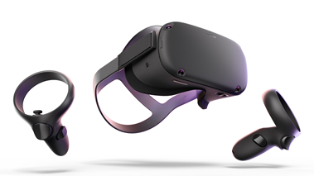
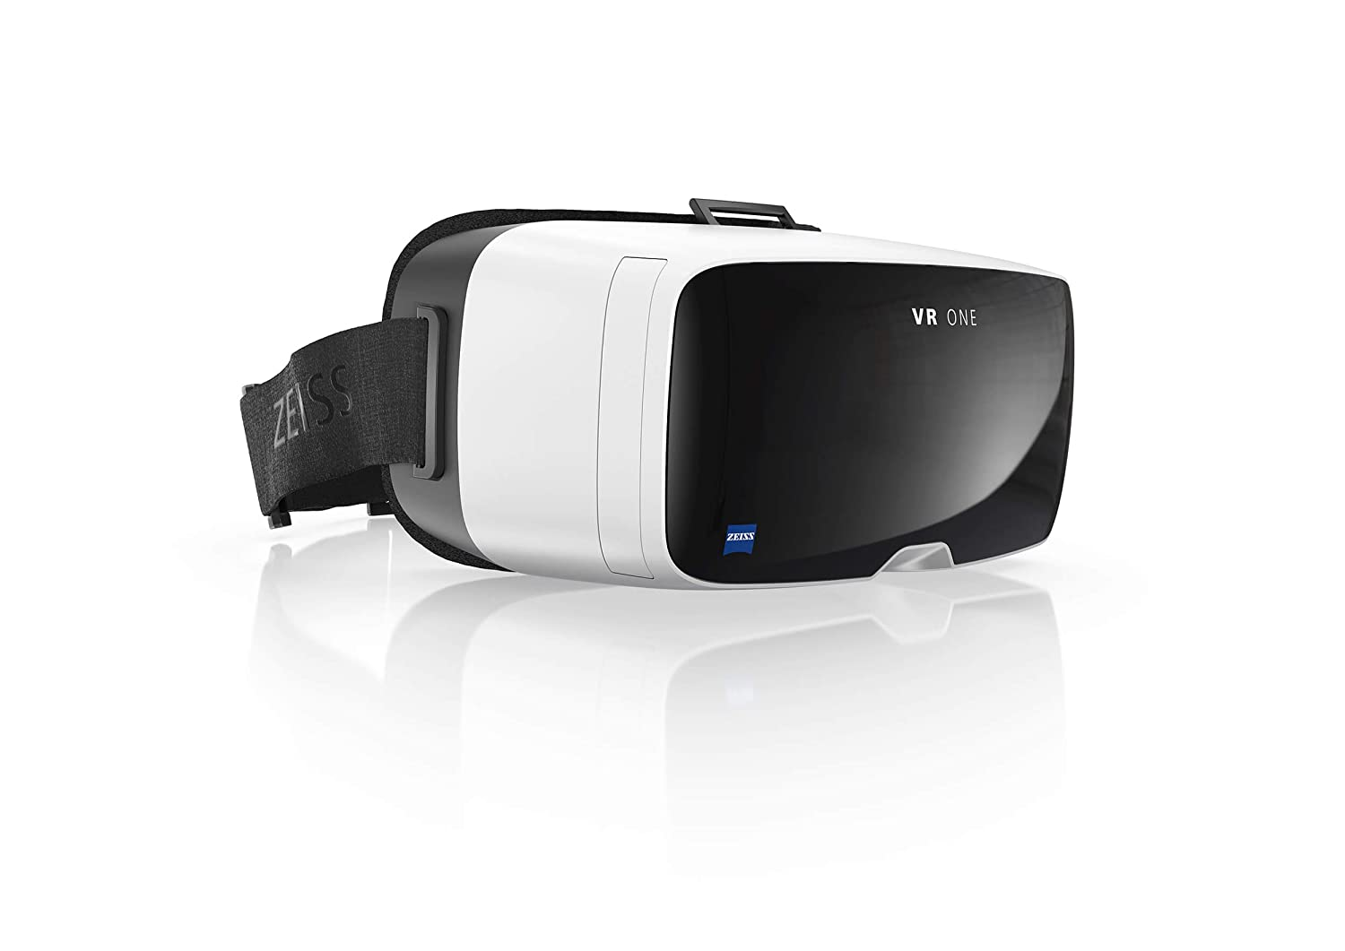
How your Students Can Experience VR:
Premium Headsets e.g. Oculus
$500
Standalone (no PC needed)
User-friendly
Maximum immersion
Cardboard/VR viewer e.g. Zeiss
$5-20 viewer
Needs Smartphone (iOs, Android)
User-friendly
Phone-only
FREE on phone
Smartphone-compatible (iOs, Android)
User-friendly
Accessible to anyone, anywhere

Slide 4
Why Use VR For Training?
VR Improves Remote Training
Immersive experiences can make distance learning feel “real.”
VR Is More Memorable
Studies show that people recall information 8% better from VR than if they merely read it.
VR & VR For Training Are Becoming Commonplace
As of 2019, there were more than 171 million VR users around the world.
Notes:
https://link.springer.com/article/10.1007%2Fs10055-018-0346-3
https://techjury.net/stats-about/virtual-reality/#gref

Slide 5
Some VR Ideas For Training
Simulate Risky Events like conflict situations or OSH incidents without putting participants at risk.
Organize Virtual Study Tours where participants can visit a location remotely.
Create 3D Scenarios where participants look at a situation from multiple perspectives.
Ignite Participants’ Creativity through three-dimensional games and videos.

Slide 6
2 Types of Skills VR Can Help Foster
Motor/Technical
Skills
Soft/Interpersonal
Skills

Slide 7
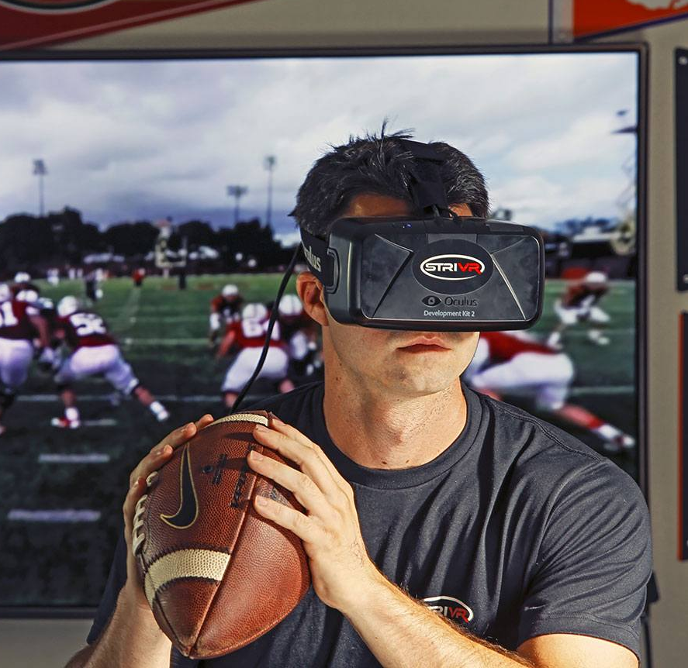
Types of Virtual Reality
Interactive Virtual Reality
VR experiences where you can interact with and influence the content you watch. VR games are interactive VR Experiences.
Non-Interactive Virtual Reality
VR experiences which you can’t interact with. 360˚ videos on YouTube are non-interactive VR experiences.

Slide 8
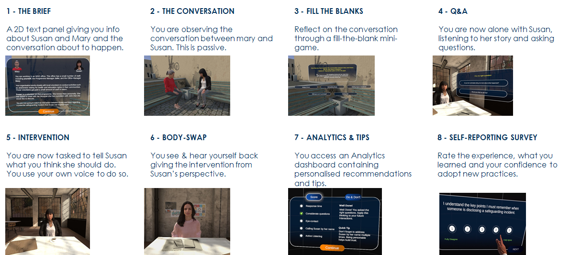
CASE STUDY: SAFEGUARDING VR
Safeguarding VR is a 20-minute experience by the Humanitarian Leadership Academy and Bodyswaps. It combines immersive Virtual Reality and conversational Artificial Intelligence to create an interactive and realistic scenario. Learners can practice having a conversation with a survivor of a safeguarding incident.
Notes:
Users can download the experience and try it out.

Slide 9
How To Create
Your 360 Video
There are many kinds of VR Films. This section focuses only on 360 Films which are the simplest to create.

Slide 10
360 video is a non-interactive VR experience where viewers can look in every direction, giving an impression of being immersed in a virtual environment. 360 videos are not interactive. To create your 360 video, you will need:
360 Camera
Phone with VR App
Headsets (Recommended)

Slide 11
6 Steps To Create
Your 360 Video
Write your script
Create a storyboard
Make a production plan
Shoot your 360 video & record sound
Edit your film
Publish your film

Slide 12
Step 1: Write Your Script
A script describes the setting as well as the actions and dialogues of characters in your film.
First define the goal of your film. What do you want students to learn?
Then define your characters (if any), the problem/tension within the film, how that problem would be solved.
Finally, write your script using this template:
Setting (Location & Time of day) | Dialogue (Who’s saying what) | Action (what’s happening)

Slide 13
Step 2: Create Your Storyboard
A storyboard is a graphic illustration of how your movie will unfold, shot by shot.
Draw out a grid of rectangles on a piece of paper.
In each rectangle, draw out a rough visual of every shot.
Below each box, add notes on what’s happening, which characters are involved, what is being said, and the location of the shot.

Slide 14
Step 3: Create A
Production Plan
The production plan includes everything you will need to create your video.
For each scene, your plan describes: who will be in it, when and where it will be shot, and what equipment & permissions will be required. You can use the template below:
WHAT
WHEN
Scene | People (Actors, Technicians) | Shooting Time | Location | Permissions Needed | Equipment Needed
WHERE

Slide 15
Step 4: Shoot Your Video
a. Connect 360 Camera To Your Phone
Make sure video is working properly.
b. Set Up Your Camera
Shoot video at 60 frames per second as this makes the video smoother. Also, use 4:3 ratio to ensure you have the largest coverage.
c. Ensure Sound Is Recording Properly
d. Keep The Camera Stable
Use a monopod or tripod to keep the camera stable at all times. Since 360 videos are immersive, shaky shoots can cause dizziness.
e. Keep Device At The Same Height As Your Line of Sight
f. Avoid Sudden Motion
Quick cuts and sudden moves are very uncomfortable for the viewers. They can lead to headaches, eye stress, and dizziness.

Slide 16
Step 5: Edit your Video
You can find tutorials on YouTube on how to edit your 360 video.
Software you can use to edit 360 video include:
DaVinci Resolve 16
Free option available. Made specifically for 360 videos.
Adobe Premiere Pro
Monthly payment. Available on Windows and Mac.
Final Cut Pro to Edit
One-time payment. Available on Mac only.

Slide 17
Step 6: Release Your Video
Before you release your 360 film:
Ensure sound is okay
Ensure video is VR Safe
Ensure content is credited
Export your video as an .mp4, .mkv or .mov. Use codec h.264
You can share your 360 video on YouTube or Facebook.

Slide 18
Watch some Examples of VR Applied to Development Work

Slide 19
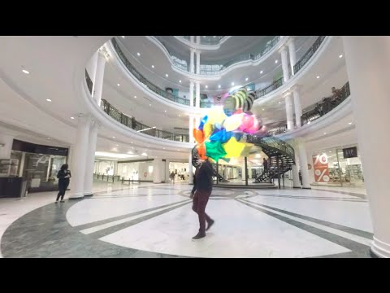
Autism Virtual Reality Experience

Slide 20
Waves of Grace - A VR Story on The Ebola Crisis

Slide 21
Clouds Over Sidra, A VR Film about the Syrian Refugee Crisis

Slide 22
The ITCILO’s Learning Innovation Programme acquired three 360 Cameras.
We want to use these to create videos that go beyond the standard 2D experience you get with an ordinary camera. Some ideas we are exploring include:
Interviewing experts in their working locations
Participant testimonials in their 3D class environment
Doing Facebook live interviews in 360 degrees

Slide 23
References and Useful Links
Humanitarian Leadership Academy
Toolkit
More VR Resources
Stanford Virtual Human Interaction Lab
International Committee of the Red Cross
WITHIN
VR Hygiene

